Slide 1



Welcome you all
Course: CSS
Day 4 (Session 1)
Table
R.Surekha
Technical Trainer,
KG Micro College
KGiSL Campus, Coimbatore – 641 035.

Slide 2
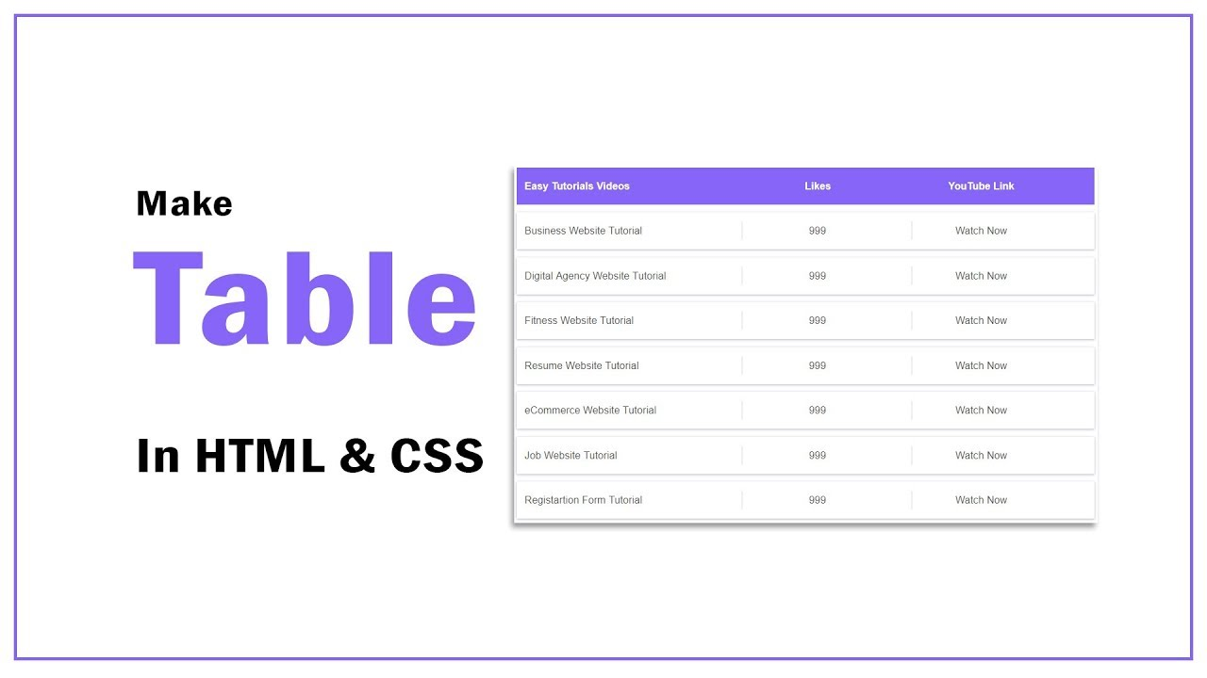

Slide 3
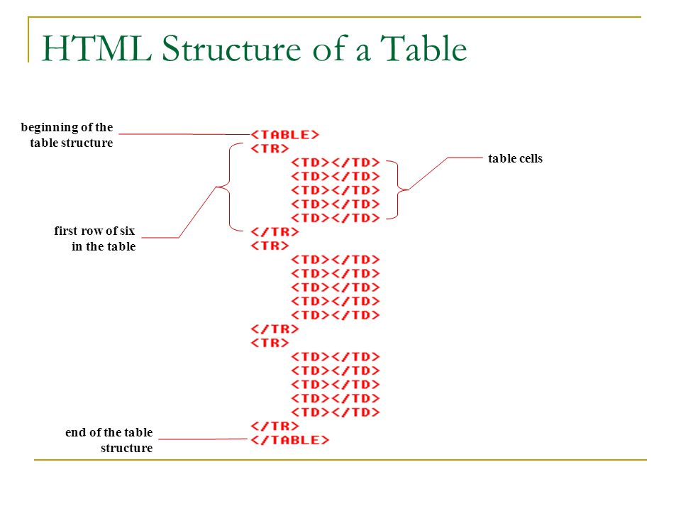

Slide 4
Styling Tables with CSS
Tables are typically used to display tabular data, such as financial reports.
But when you create an HTML table without any styles or attributes, browsers display them without any border. With CSS you can greatly improve the appearance your tables.

Slide 5
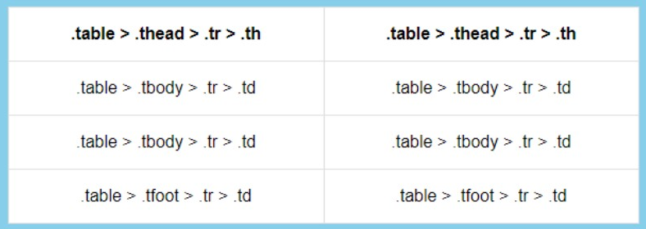
<table>
<thead>
<tr><th></th><th></th></tr>
</thead>
<tbody>
<tr><td></td><td></td></tr>
<tr><td></td><td></td></tr>
<tr><td></td><td></td></tr>
</tbody>
<tfoot>
<tr><td></td><td></td></tr>
</tfoot>

Slide 6
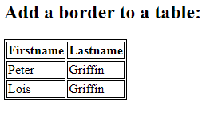
Table Borders
To specify table borders in CSS, use the border property.
The example below specifies a solid border for <table>, <th>, and <td> elements:

Slide 7
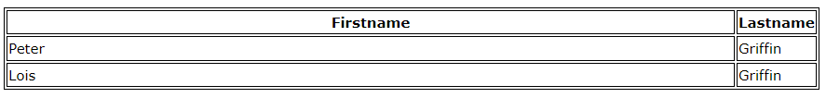
Full-Width Table
The table above might seem small in some cases. If you need a table that should span the entire screen (full-width), add width: 100% to the <table> element:
table { width: 100%; }

Slide 8
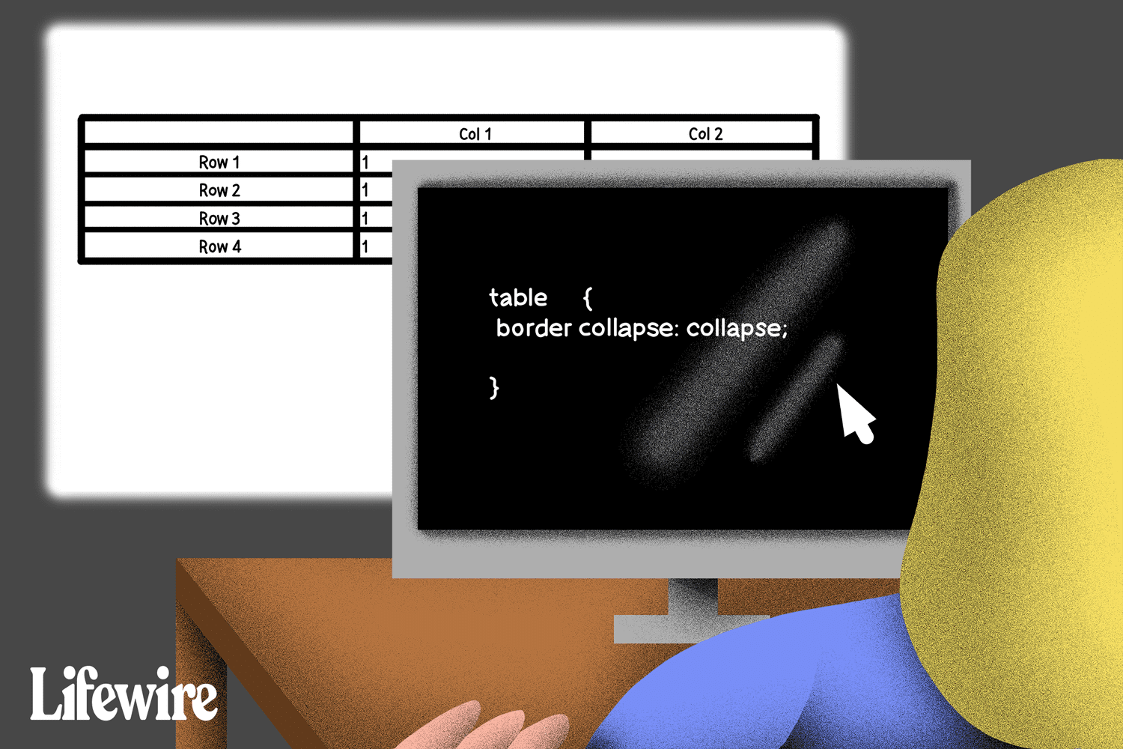
Collapse Table Borders
The border-collapse property sets whether the table borders should be collapsed into a single border:

Slide 9
Adjusting Space inside Tables
By default, the browser creates the table cells just large enough to contain the data in the cells.
th, td { padding: 15px; }
table { border-spacing: 10px; }

Slide 10
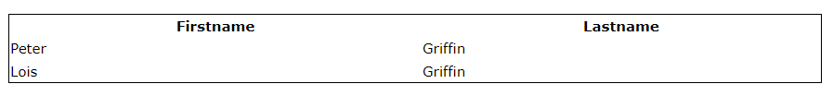
border around the table, only specify the border property for <table>:
table { border: 1px solid; }

Slide 11
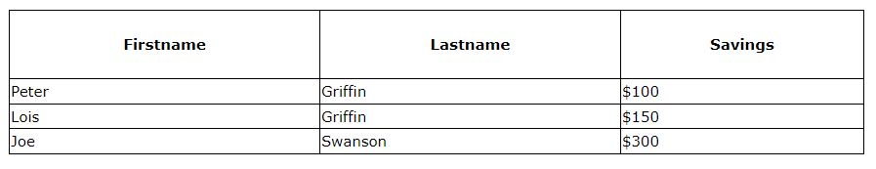
CSS Table Size
Table Width and Height
The width and height of a table are defined by the width and height properties.
The example below sets the width of the table to 100%, and the height of the <th> elements to 70px:
table { width: 100%; } th { height: 70px; }

Slide 12
Controlling the Table Layout
A table expands and contracts to accommodate the data contained inside it. This is the default behavior. As data fills inside the table, it continues to expand as long as there is space. Sometimes, however, it is necessary to set a fixed width for the table in order to manage the layout.
You can do this with the help of CSS table-layout property. This property defines the algorithm to be used to layout the table cells, rows, and columns. This property takes one of two values:
auto — Uses an automatic table layout algorithm. With this algorithm, the widths of the table and its cells are adjusted to fit the content. This is the default value.
fixed — Uses the fixed table layout algorithm. With this algorithm, the horizontal layout of the table does not depend on the contents of the cells; it only depends on the table's width, the width of the columns, and borders or cell spacing. It is normally faster than auto.
table {
width: 300px; table-layout: fixed;
}

Slide 13
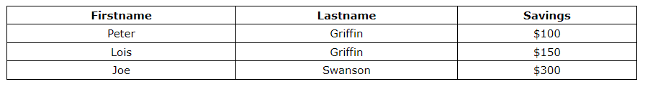
CSS Table Alignment
Horizontal Alignment
The text-align property sets the horizontal alignment (like left, right, or center) of the content in <th> or <td>.
By default, the content of <th> elements are center-aligned and the content of <td> elements are left-aligned.
To center-align the content of <td> elements as well, use text-align: center:
td { text-align: center; }

Slide 14
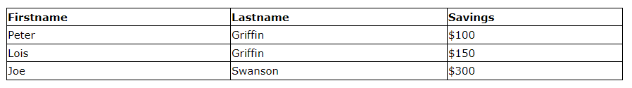
To left-align the content, force the alignment of <th> elements to be left-aligned, with the text-align: left property:
th { text-align: left; }

Slide 15
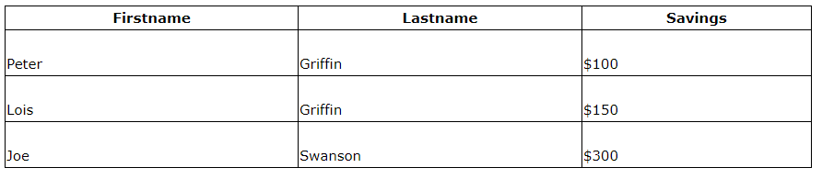
Vertical Alignment
The vertical-align property sets the vertical alignment (like top, bottom, or middle) of the content in <th> or <td>.
By default, the vertical alignment of the content in a table is middle (for both <th> and <td> elements).
The following example sets the vertical text alignment to bottom for <td> elements:
td { height: 50px; vertical-align: bottom; }

Slide 16
Controlling the Position of Table Caption
You can set the vertical position of a table caption using the CSS caption-side property.
The caption can be placed either at the top or bottom of the table. The default position is top.
caption {
caption-side: bottom;
}

Slide 17
Handling Empty Cells
In tables that uses separate border model, which is default, you can also control the rendering of the cells that have no visible content using the empty-cells CSS property.
table {
border-collapse: separate;
empty-cells: hide;
}

Slide 18
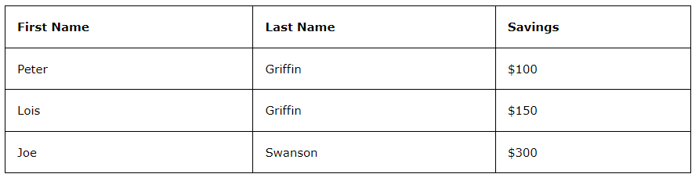
CSS Table Style
Table Padding
To control the space between the border and the content in a table, use the padding property on <td> and <th> elements:
th, td { padding: 15px; text-align: left; }

Slide 19
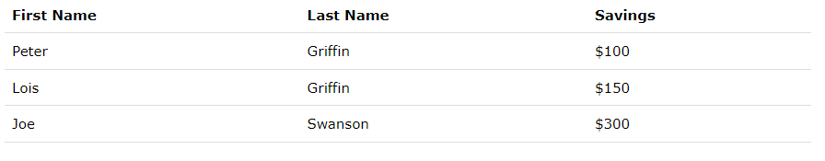
Horizontal Dividers
Add the border-bottom property to <th> and <td> for horizontal dividers.
th, td { border-bottom: 1px solid #ddd; }

Slide 20
Pseudo-classes
A CSS pseudo-class is a keyword added to a selector that specifies a special state of the selected element(s). For example, the pseudo-class :hover can be used to select a button when a user's pointer hovers over the button and this selected button can then be styled.
selector:pseudo-class { property: value; }
/* Any button over which the user's pointer is hovering */
button:hover { color: blue; }
A pseudo-class consists of a colon (:) followed by the pseudo-class name (e.g., :hover). A functional pseudo-class also contains a pair of parenthesis to define the arguments (e.g., :dir()). The element that a pseudo-class is attached to is defined as an anchor element (e.g., button in case button:hover).

Slide 21
The :first-child Pseudo-class
The :first-child pseudo-class matches an element that is the first child element of some other element. The selector ol li:first-child in the example below select the first list item of an ordered list and removes the top border form it.

Slide 22
<!DOCTYPE html>
<html lang="en">
<head>
<meta charset="utf-8">
<title>Example of CSS :first-child Pseudo-class</title>
<style>
ol{
padding: 0;
list-style: none;
}
ol li{
padding: 10px 0;
border-top: 1px solid #000000;
}
li:first-child {
border-top: none;
}
</style>
</head>

Slide 23
<body>
<h1>Sample Ordered Lists</h1>
<ol>
<li>Mix ingredients</li>
<li>Bake in oven for an hour</li>
<li>Allow to stand for ten minutes</li>
</ol>
<p><strong>Note:</strong> To make <code>:first-child</code> to work in IE8 and earlier, a <code><!DOCTYPE></code> must be declared at the top of document.</p>
</body>
</html>

Slide 24
The :last-child Pseudo-class
The :last-child pseudo-class matches an element that is the last child element of some other element. The selector ul li:last-child in the example below select the last list item from an unordered list and removes the right border from it.

Slide 25
<!DOCTYPE html>
<html lang="en">
<head>
<meta charset="utf-8">
<title>Example of CSS :first-child Pseudo-class</title>
<style>
ul{
padding: 0;
list-style: none;
}
ul li{
display: inline;
padding: 0 20px;
border-right: 1px solid #000000;
}
li:last-child {
border-right: none;
}
</style>
</head>
<body>

Slide 26
<h1>Sample Navigation Bar</h1>
<ul>
<li>Home</li>
<li>About Us</li>
<li>Services</li>
<li>Contact Us</li>
</ul>
<p><strong>Note:</strong> To make <code>:first-child</code> to work in IE8 and earlier, a <code><!DOCTYPE></code> must be declared at the top of document.</p>
</body>
</html>

Slide 27
The :nth-child Pseudo-class
The CSS3 introduces a new :nth-child pseudo-class that allows you to target one or more specific children of a given parent element. The basic syntax of this selector can be given with :nth-child(N), where N is an argument, which can be a number, a keyword (even or odd), or an expression of the form xn+y where x and y are integers (e.g. 1n, 2n, 2n+1, …).
table tr th, table tr td{
padding: 10px;
}
table tr:nth-child(2n) td{
background: #f2f2f2;
}

Slide 28
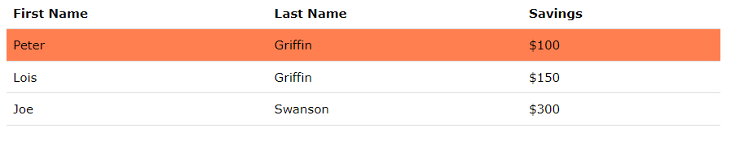
Hoverable Table
Use the :hover selector on <tr> to highlight table rows on mouse over.
tr:hover {background-color: coral;}

Slide 29
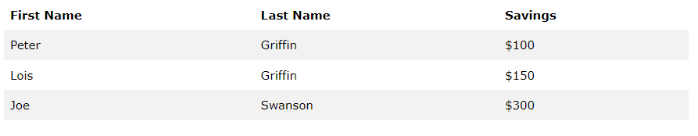
Striped Tables
For zebra-striped tables, use the nth-child() selector and add a background-color to all even (or odd) table rows.
tr:nth-child(even) {
background-color: #f2f2f2;
}

Slide 30
Table Color
The example below specifies the background color and text color of <th> elements:
table {
background-color:yellow;
}

Slide 31

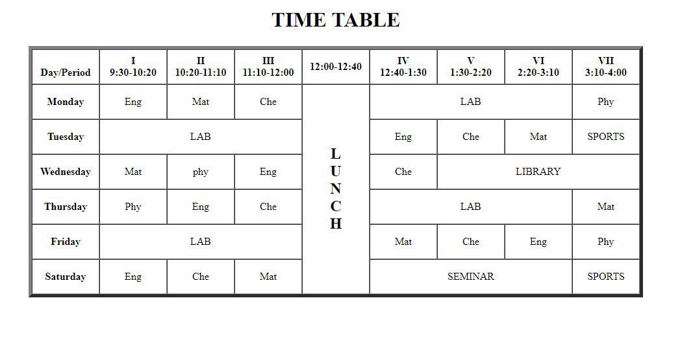
Excerise 1

Slide 32
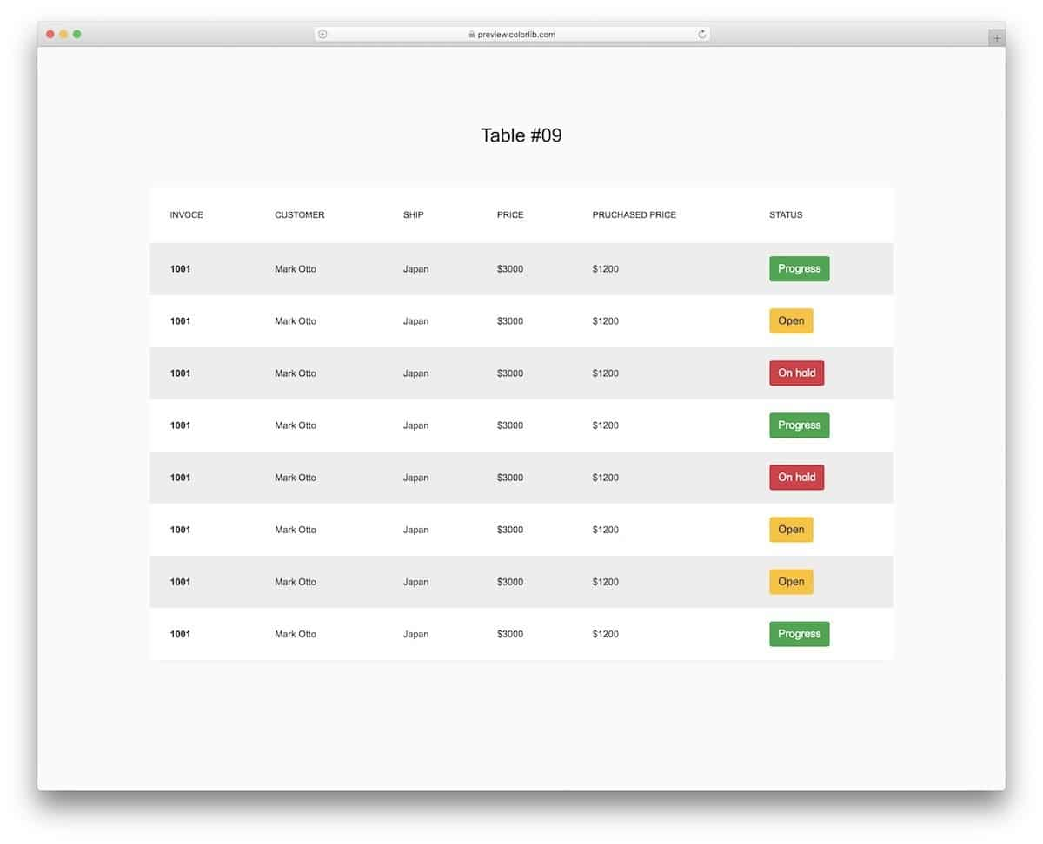
Excerise 2

Slide 33

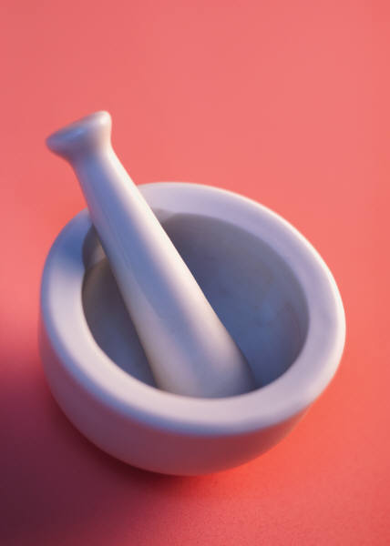

Thank You

